Slide 1
INTRODUCTION TO SQL
DBMS-1002

Slide 2
Last Time...we covered these questions:
What is: a Database, a DBMS, a Flat File.
What is a Table? Row? Column?
What are the differences between simple/composite and stored/derived attributes?
What is a datatype?
How did we interact with a database from an application?

Slide 3
In These Slides . . .
We will be covering:
A brief history of SQL
DDL vs DML
Making basic queries with SELECT
Commenting SQL
Renaming columns

Slide 4
SQL - Definition
Example SQL:
SQL is short for Structured Query Language
Languages are syntax driven:
What we say
What order we say it
SQL allows us to manipulate data stored in a relational database management system (DBMS)
SELECT *
FROM Regions;

Slide 5
SQL - A Brief History
SQL became a standard of the American National Standards Institute (ANSI) in 1986
Followed by the International Organization for Standardization (ISO) in 1987
Despite these standards, SQL code will vary slightly between database systems
Example Database Systems include: MySQL, Microsoft SQL, PostGres, Oracle, etc...

Slide 6
SQL - What does it do?
SQL is used to:
Create the database
Create the Tables in a database
Insert the rows into a table
Retrieve and maintain data in the tables
Add/Remove users from the database
Enforce security
… and much more!

Slide 7
SQL - DDL Type
SQL can be broken into two categories: DDL and DML
Data Definition Language (DDL)
Used to Modify The Structure of the database
Examples of DDL keywords:
DROP
ALTER
CREATE
We will come back to these concepts later in the course!

Slide 8
SQL - DML Type
2. Data Manipulation Language (DML)
Used to Manipulate The Data within the structure
Example DML keyword verbs:
SELECT
UPDATE
INSERT
DELETE
In these slides we will start to cover: SELECT

Slide 9
SQL Basics
Create a new empty worksheet in PostgreSQL. (Choose Pgadmin from the Start button)
Save your worksheet immediately with an appropriate name such as: SQL_Basics_Demo.sql
You are encouraged to write your own comments as your instructor lectures

Slide 10
SQL Basics - SELECT
SELECT lets you retrieve data from tables.
The full form of the SELECT statement may consist of many clauses:
FROM (required)
WHERE
ORDER BY
GROUP BY and HAVING
These last two will be discussed later in the course
Notes:
Activity:
Let’s suppose you work in an optical store as a salesperson.
A potential client comes in. This customer has a disability and can’t speak or write. All the customer can do is let you know is yes or no by nodding.
Brainstorm with a partner the kind of questions you would ask the potential customer to help them pick the glasses they need.

Slide 11
SQL Basics - Commenting
To make a comment in SQL we use either:
-- for single lines
/* */ for multiple lines
Example:
-- This is a single line comment
/* This is a
multiline comment */

Slide 12
SQL Basics - Commenting
When using multiple commented lines.
Once you write the 2 starting characters: /*
All symbols and characters will be ignored entirely by the editor until the ending 2 characters: */
/*
This is another
multiline comment …
******-----...?><”:}{|@!(#)_+~`’/*42
*/

Slide 13
Entity Relationship Diagram (ERD)
On the following screen is the Entity Relationship Diagram (ERD) which depicts the database we will be using throughout the remainder of the course.
We do not need to fully understand this diagram right now.
It is presented in the slides for your convenience and for context as we will be using the names of the tables and columns in the slides to follow.

Slide 14
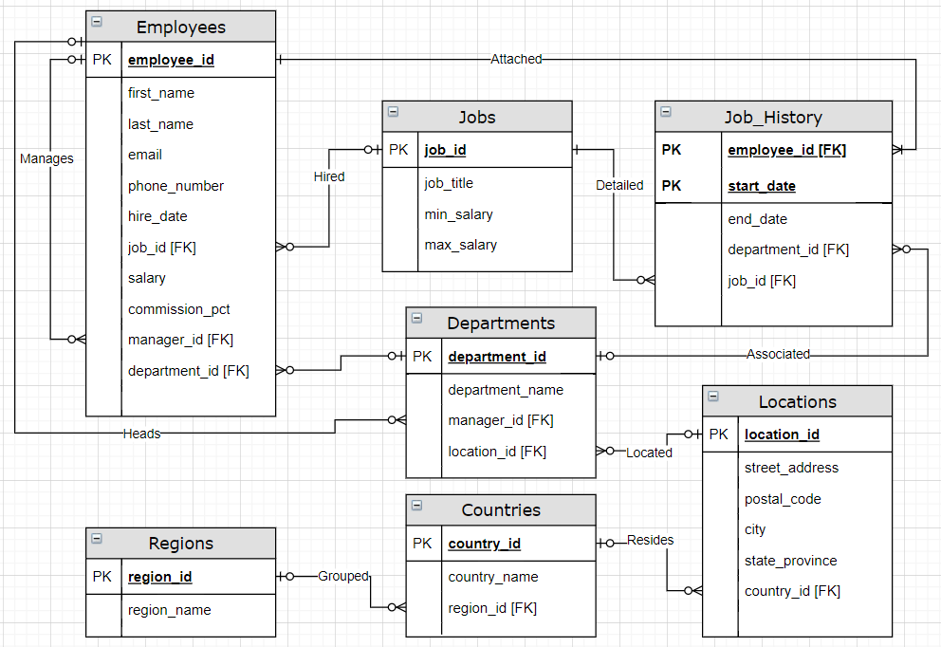
Our HR Database ERD at a glance

Slide 15
SQL Basics - Commenting
Try it! Type this SQL code into your empty worksheet and press the PLAY button.
Use this style of commenting to add extra notes or your own thoughts as we progress through the course!
/* The following SQL selects all the rows in the Regions table: */
SELECT *
FROM Regions;
Columns/Attributes
Table Name

Slide 16
SQL Basics - SELECT
A SELECT must define which columns to display from which table
In our example we used the asterix symbol instead of column names
The * is a wild card value, meaning all columns will be returned
The FROM clause indicates which table to fetch the rows from.
Lastly, the semicolon at the end indicates that this is the end of our query.
SELECT *
FROM Regions;

Slide 17
SELECT Columns
Let’s specify the columns we want to return:
TRY IT! (then experiment)
What happens when you delete one of the column names?
What happens when you reverse the order of the column names?
Try all capitals: REGION_ID
SELECT region_id, region_name
FROM Regions;

Slide 18
Rename SELECT Columns
Renaming columns with the AS keyword is useful:
TRY IT! (then experiment)
Write: region_id AS RegionID
NOTE: You do not need double quotes if you are not using spaces
SELECT region_id AS "Region ID",
region_name AS "Region Name"
FROM Regions;

Slide 19
Rename SELECT Columns
SELECT region_id AS "Region ID",
region_name AS "Region Name"
FROM Regions;
Why might we want to rename a column?
Names may contain special characters
Names may be abbreviated
Names may lack an obvious meaning
An expression is used as a column name (more on this later)

Slide 20
Rename SELECT Columns
TRY IT! Make a select on each of the tables in our ERD
Can you see how the data is related to each other from table to table? We will be talking about this a lot in the next few modules!

Slide 21
Summary
We can now answer the following questions:
What is DDL?
What is DML?
What are some of the key words used in an SQL QUERY?
What symbol do we use for single line comments?
How do we make multi-line comments in SQL?
What key word do we use when renaming a column?
What are the names of some of the tables in our ERD?

Slide 22
Up Next . . .
SQL Basics!
Using the WHERE clause
Understanding Data Types better!

